Slide 1
02 - Word Classes
Nick Riches
Words
Definition
Symbols
Standalone
Minimal (cannot be split)
02 - Word Classes
Word classes
The ‘standard’ definition
Meaning
Form test
Position test So which test?
Nick Riches
Newcastle University
Let’s meet the word classes!
Ways to categorise word classes
Open versus closed-class words
Where are they found?
Word classes and language impairment
October 7, 2019
5 minute exercise
5 minute exercies
1 / 27

Slide 2
02 - Word Classes
Nick Riches
Words
Definition
Symbols
Standalone
Minimal (cannot be split)
Words
Word classes
The ‘standard’ definition
Meaning
Form test
Position test So which test?
Word classes
Let’s meet the word classes!
Let’s meet the word classes!
Ways to categorise word classes
Open versus closed-class words
Where are they found?
Word classes and language impairment
5 minute exercise
5 minute exercise
5 minute exercies
1 / 27

Slide 3
Definition
02 - Word Classes
Nick Riches
Words
Definition
Symbols
Standalone
Minimal (cannot be split)
Word classes
The ‘standard’ definition
Meaning
Form test
Position test So which test?
‘minimal standalone symbolic unit’ MiSS
Let’s meet the word classes!
Ways to categorise word classes
Open versus closed-class words
Where are they found?
Word classes and language impairment
5 minute exercise
5 minute exercies
2 / 27

Slide 4



1. Symbols
02 - Word Classes
Nick Riches
Words
Definition
Symbols
Standalone
Minimal (cannot be split)
Symbols versus Icons
Word classes
The ‘standard’ definition
Meaning
Form test
Position test So which test?
Let’s meet the word classes!
Ways to categorise word classes
Open versus closed-class words
Where are they found?
Word classes and language impairment
Symbols are characterised by an arbitrary relationship between form and meaning.
5 minute exercise
5 minute exercies
3 / 27

Slide 5

1. Symbols
02 - Word Classes
Nick Riches
Words
Definition
Symbols
Standalone
Minimal (cannot be split)
Word classes
The ‘standard’ definition
Meaning
Form test
Position test So which test?
Let’s meet the word classes!
Ways to categorise word classes
Open versus closed-class words
Where are they found?
Word classes and language impairment
5 minute exercise
5 minute exercies
4 / 27

Slide 6
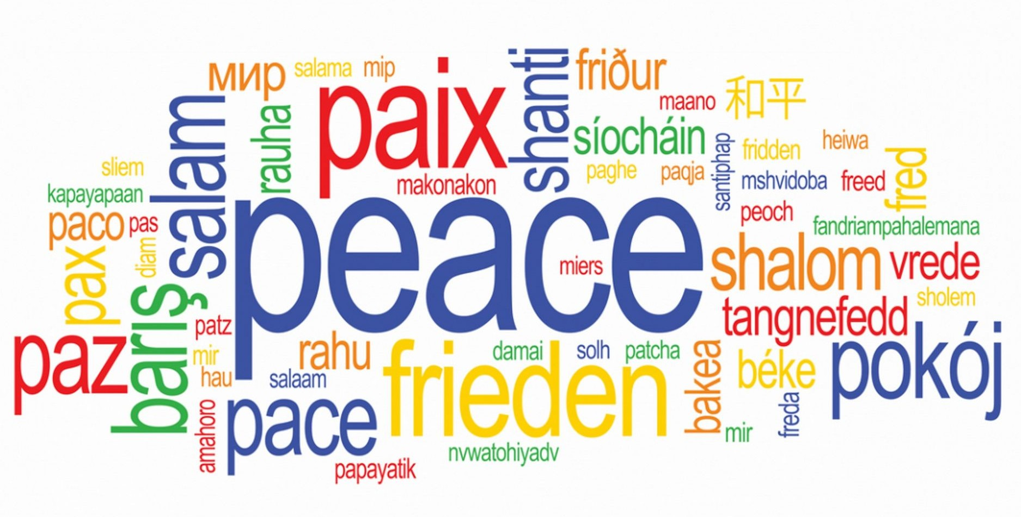
1. Symbols
02 - Word Classes
Nick Riches
Words
Definition
Symbols
Standalone
Minimal (cannot be split)
Word classes
The ‘standard’ definition
Meaning
Form test
Position test So which test?
Let’s meet the word classes!
Ways to categorise word classes
Open versus closed-class words
Where are they found?
Word classes and language impairment
5 minute exercise
5 minute exercies
5 / 27

Slide 7
2. Standalone
02 - Word Classes
Nick Riches
Words
Definition
Symbols
Standalone
Minimal (cannot be split)
Word classes
The ‘standard’ definition
Meaning
Form test
Position test So which test?
A: What was he doing? B: Working
A: How would you describe the experience? B: Unbelievable
A: How are you feeling? B: Unhappy Shark!!!!!!!! Swim!!!!!!!!!
Let’s meet the word classes!
Ways to categorise word classes
Open versus closed-class words
Where are they found?
Word classes and language impairment
5 minute exercise
5 minute exercies
6 / 27

Slide 8
3. Minimal (cannot be split)
02 - Word Classes
Nick Riches
Words
Definition
Symbols
Standalone
Minimal (cannot be split)
1. Inactive → *One sip of coffee and Charles changes
Word classes
The ‘standard’ definition
Meaning
Form test
Position test So which test?
from in- to hyper-active.
2. Underconfident → ?After eight pints, Angela changes
from under- to overconfident.
Let’s meet the word classes!
Ways to categorise word classes
Open versus closed-class words
Where are they found?
Word classes and language impairment
3. Walk out → She walked through the door and out of
my life.
4. Blackbird (species) → *She saw a black and a white
bird in the tree
5 minute exercise
5 minute exercies
7 / 27

Slide 9
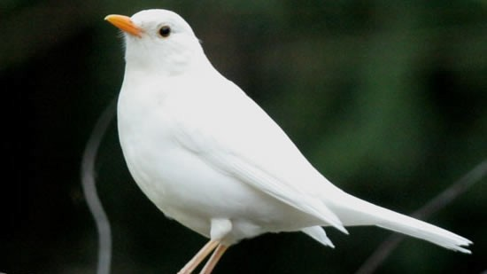
3. Minimal (cannot be split)
02 - Word Classes
Nick Riches
Words
Definition
Symbols
Standalone
Minimal (cannot be split)
Word classes
The ‘standard’ definition
Meaning
Form test
Position test So which test?
Let’s meet the word classes!
Ways to categorise word classes
Open versus closed-class words
Where are they found?
Word classes and language impairment
5 minute exercise
5 minute exercies
8 / 27

Slide 10
02 - Word Classes
Nick Riches
Words
Definition
Symbols
Standalone
Minimal (cannot be split)
Words
Word classes
The ‘standard’ definition
Meaning
Form test
Position test So which test?
Word classes
Let’s meet the word classes!
Let’s meet the word classes!
Ways to categorise word classes
Open versus closed-class words
Where are they found?
Word classes and language impairment
5 minute exercise
5 minute exercise
5 minute exercies
8 / 27

Slide 11
The ‘standard’ definition
02 - Word Classes
Nick Riches
Words
Definition
Symbols
Standalone
Minimal (cannot be split)
Word classes
The ‘standard’ definition
Meaning
Form test
Position test So which test?
A verb is a DOING word
An adjective is a DESCRIBING word
Let’s meet the word classes!
Ways to categorise word classes
Open versus closed-class words
Where are they found?
Word classes and language impairment
5 minute exercise
5 minute exercies
9 / 27

Slide 12
The ‘standard’ definition
02 - Word Classes
Nick Riches
Words
Definition
Symbols
Standalone
Minimal (cannot be split)
Word classes
The ‘standard’ definition
Meaning
Form test
Position test So which test?
The raging river tore through the valley
That film really sucks
Let’s meet the word classes!
Ways to categorise word classes
Open versus closed-class words
Where are they found?
Word classes and language impairment
5 minute exercise
5 minute exercies
10 / 27

Slide 13
1. Meaning
02 - Word Classes
Nick Riches
Words
Definition
Symbols
Standalone
Minimal (cannot be split)
Word classes
The ‘standard’ definition
Meaning
Form test
Position test So which test?
(1) Meaning test
e.g. A verb is a ‘doing’ word
Let’s meet the word classes!
Ways to categorise word classes
Open versus closed-class words
Where are they found?
Word classes and language impairment
5 minute exercise
5 minute exercies
11 / 27

Slide 14
2. Form test
02 - Word Classes
Nick Riches
Words
Definition
Symbols
Standalone
Minimal (cannot be split)
Word classes
The ‘standard’ definition
Meaning
Form test
Position test So which test?
e.g. we can make a verb progressive by adding -ing
Let’s meet the word classes!
Ways to categorise word classes
Open versus closed-class words
Where are they found?
Word classes and language impairment
5 minute exercise
5 minute exercies
12 / 27

Slide 15
3. Position test
02 - Word Classes
Nick Riches
Words
Definition
Symbols
Standalone
Minimal (cannot be split)
Word classes
The ‘standard’ definition
Meaning
Form test
Position test So which test?
Where a word comes in a sentence (sometimes called ‘distribution’)
e.g. verbs come after subjects and before objects, e.g. she ate the fish
she likes cheese.
Let’s meet the word classes!
Ways to categorise word classes
Open versus closed-class words
Where are they found?
Word classes and language impairment
5 minute exercise
5 minute exercies
13 / 27

Slide 16
3. Position test
02 - Word Classes
Nick Riches
Words
Definition
Symbols
Standalone
Minimal (cannot be split)
Word classes
The ‘standard’ definition
Meaning
Form test
Position test So which test?
Let’s meet the word classes!
Ways to categorise word classes
Open versus closed-class words
Where are they found?
Word classes and language impairment
5 minute exercise
5 minute exercies
14 / 27

Slide 17
So which test?
02 - Word Classes
Nick Riches
Words
Definition
Symbols
Standalone
Minimal (cannot be split)
Word classes
The ‘standard’ definition
Meaning
Form test
Position test So which test?
The raging river tore through the valley
That film really sucks
Let’s meet the word classes!
Ways to categorise word classes
Open versus closed-class words
Where are they found?
Word classes and language impairment
5 minute exercise
5 minute exercies
15 / 27

Slide 18
02 - Word Classes
Nick Riches
Words
Definition
Symbols
Standalone
Minimal (cannot be split)
Words
Word classes
The ‘standard’ definition
Meaning
Form test
Position test So which test?
Word classes
Let’s meet the word classes!
Let’s meet the word classes!
Ways to categorise word classes
Open versus closed-class words
Where are they found?
Word classes and language impairment
5 minute exercise
5 minute exercise
5 minute exercies
15 / 27

Slide 19
Ways to categorise word classes
02 - Word Classes
Nick Riches
Words
Definition
Symbols
Standalone
Minimal (cannot be split)
Word classes
The ‘standard’ definition
Meaning
Form test
Position test So which test?
Open versus closed class (Content versus function)
Where in the sentence are particular word classes found?
Let’s meet the word classes!
Ways to categorise word classes
Open versus closed-class words
Where are they found?
Word classes and language impairment
link to table
5 minute exercise
5 minute exercies
16 / 27

Slide 20

Open versus closed-class words
02 - Word Classes
Nick Riches
Words
Definition
Symbols
Standalone
Minimal (cannot be split)
Word classes
The ‘standard’ definition
Meaning
Form test
Position test So which test?
Let’s meet the word classes!
Ways to categorise word classes
Open versus closed-class words
Where are they found?
Word classes and language impairment
5 minute exercise
5 minute exercies
17 / 27

Slide 21
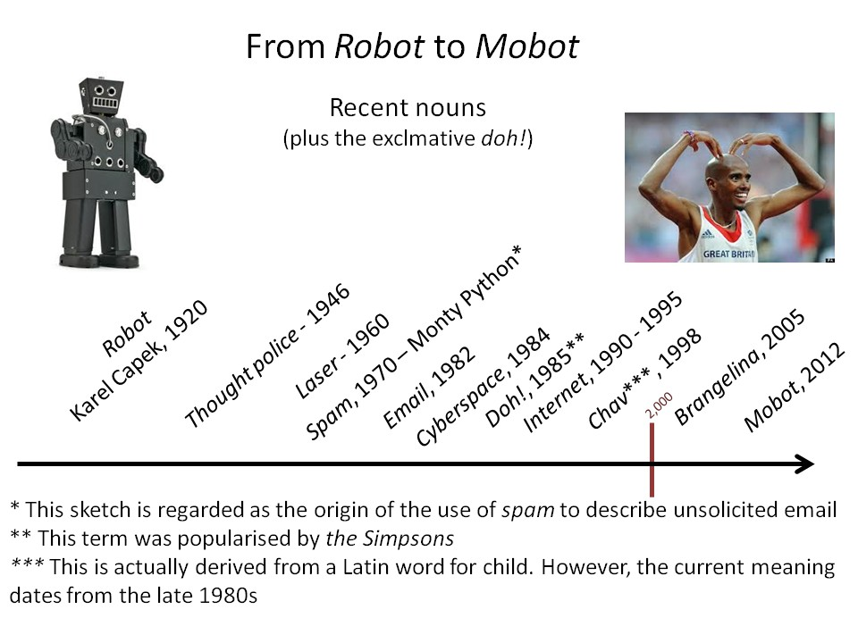
Open versus closed-class words
02 - Word Classes
Nick Riches
Words
Definition
Symbols
Standalone
Minimal (cannot be split)
Word classes
The ‘standard’ definition
Meaning
Form test
Position test So which test?
Let’s meet the word classes!
Ways to categorise word classes
Open versus closed-class words
Where are they found?
Word classes and language impairment
5 minute exercise
5 minute exercies
18 / 27

Slide 22
Where are they found?
02 - Word Classes
Nick Riches
Words
Definition
Symbols
Standalone
Minimal (cannot be split)
Word classes
The ‘standard’ definition
Meaning
Form test
Position test So which test?
Word classes which come inside the ‘Noun Phrase’
     

DET.
 
ADV.
 
ADJ.

the
really very
lovely mean furry
Let’s meet the word classes!
Ways to categorise word classes
Open versus closed-class words
Where are they found?
Word classes and language impairment
cats _{NOUN}
like fish

these
 
 


 
 

some totally
5 minute exercise
5 minute exercies
19 / 27

Slide 23
Where are they found?
02 - Word Classes
Nick Riches
Words
Definition
Symbols
Standalone
Minimal (cannot be split)
Word classes
The ‘standard’ definition
Meaning
Form test
Position test So which test?
Pronouns:
Stand in for entire Noun Phrase
the marshmallow coated chocolate fudge cake
Let’s meet the word classes!
Ways to categorise word classes
Open versus closed-class words
Where are they found?
Word classes and language impairment
I liked
it
5 minute exercise
5 minute exercies
20 / 27

Slide 24
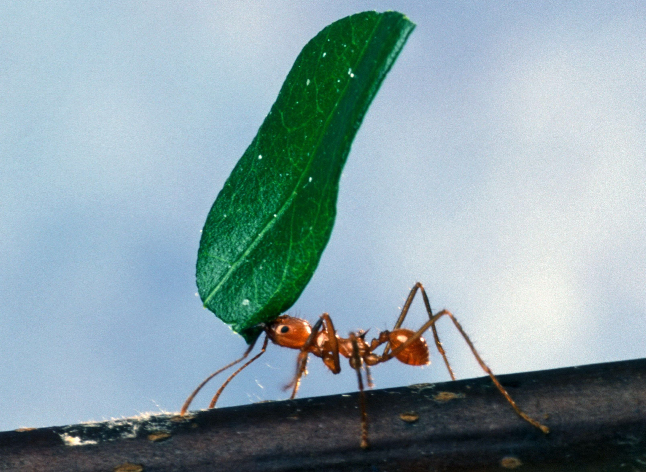
Where are they found?
02 - Word Classes
Nick Riches
Words
Definition
Symbols
Standalone
Minimal (cannot be split)
Word classes
The ‘standard’ definition
Meaning
Form test
Position test So which test?
Let’s meet the word classes!
Ways to categorise word classes
Open versus closed-class words
Where are they found?
Word classes and language impairment
5 minute exercise
5 minute exercies
21 / 27

Slide 25
Where are they found?
02 - Word Classes
Nick Riches
Words
Definition
Symbols
Standalone
Minimal (cannot be split)
Word classes
The ‘standard’ definition
Meaning
Form test
Position test So which test?
Word classes which come inside ‘the Verb Complex’
 

ADV.



Let’s meet the word classes!
Ways to categorise word classes
Open versus closed-class words
Where are they found?
Word classes and language impairment
AUX.
always
The cats
licking _{VERB}
the bowl.
are

greedily really



5 minute exercise
5 minute exercies
22 / 27

Slide 26
Where are they found?
02 - Word Classes
Nick Riches
Words
Definition
Symbols
Standalone
Minimal (cannot be split)
Word classes
The ‘standard’ definition
Meaning
Form test
Position test So which test?
The three types of adverb.
Modifies verb
, I really enjoy having a really long bath.
Modifies adjective
Let’s meet the word classes!
Ways to categorise word classes
Open versus closed-class words
Where are they found?
Word classes and language impairment
Really
Modifies sentence
5 minute exercise
5 minute exercies
23 / 27

Slide 27
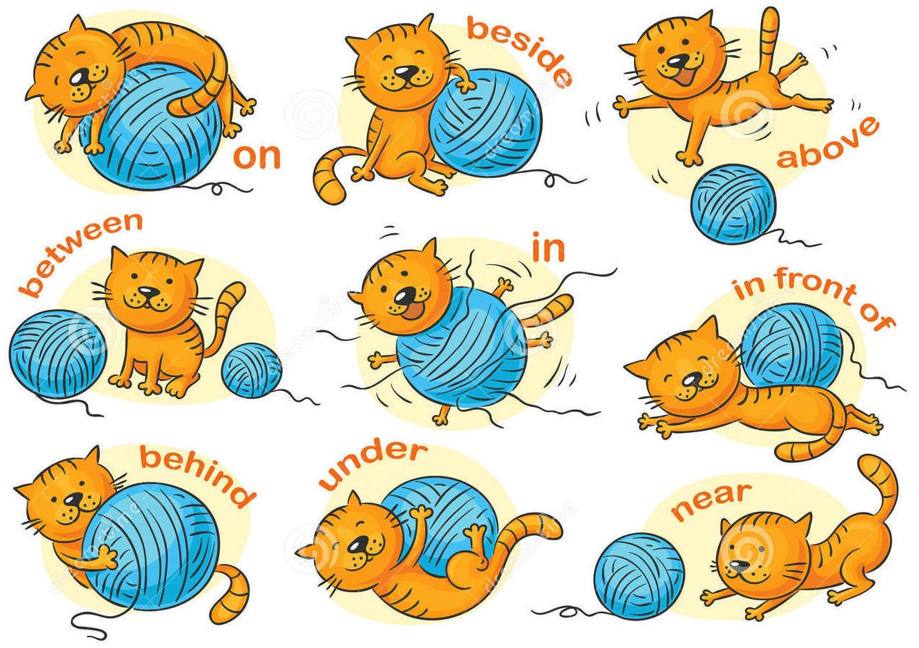
Where are they found?
02 - Word Classes
Nick Riches
Prepositions:
Words
Definition
Symbols
Standalone
Minimal (cannot be split)
Word classes
The ‘standard’ definition
Meaning
Form test
Position test So which test?
Let’s meet the word classes!
Ways to categorise word classes
Open versus closed-class words
Where are they found?
Word classes and language impairment
5 minute exercise
5 minute exercies
24 / 27

Slide 28
Where are they found?
02 - Word Classes
Nick Riches
Words
Definition
Symbols
Standalone
Minimal (cannot be split)
Word classes
The ‘standard’ definition
Meaning
Form test
Position test So which test?
Examples of prepositions



with
[his pet dog ] [a log cabin]

He’s been living
in
Let’s meet the word classes!
Ways to categorise word classes
Open versus closed-class words
Where are they found?
Word classes and language impairment

in
[the wilds of Alaska] for [many years]



5 minute exercise
5 minute exercies
25 / 27

Slide 29
Word classes and language impairment
02 - Word Classes
Nick Riches
Words
Definition
Symbols
Standalone
Minimal (cannot be split)
Word classes
The ‘standard’ definition
Meaning
Form test
Position test So which test?
Children with language impairments
Tend to miss out function words
Have difficulties understanding prepositions (when used to express location), e.g. on, in
Have reduced verb diversity, e.g. ‘She did the food’
Let’s meet the word classes!
Ways to categorise word classes
Open versus closed-class words
Where are they found?
Word classes and language impairment
5 minute exercise
5 minute exercies
26 / 27

Slide 30
02 - Word Classes
Nick Riches
Words
Definition
Symbols
Standalone
Minimal (cannot be split)
Words
Word classes
The ‘standard’ definition
Meaning
Form test
Position test So which test?
Word classes
Let’s meet the word classes!
Let’s meet the word classes!
Ways to categorise word classes
Open versus closed-class words
Where are they found?
Word classes and language impairment
5 minute exercise
5 minute exercise
5 minute exercies
26 / 27

Slide 31
5 minute exercies
02 - Word Classes
Nick Riches
Words
Definition
Symbols
Standalone
Minimal (cannot be split)
Word classes
The ‘standard’ definition
Meaning
Form test
Position test So which test?
Whatˆas unusual about the following sentence: ‘That film was absobloodylutely brilliant!?’
A student says ‘I am going to a lection’. What does ‘lection’ mean, and how has this error arisen?
Let’s meet the word classes!
Ways to categorise word classes
Open versus closed-class words
Where are they found?
Word classes and language impairment
5 minute exercise
5 minute exercies
27 / 27

